Slide 1
Initial Results Based on 300 Simulations

Slide 2
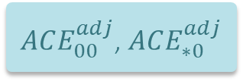
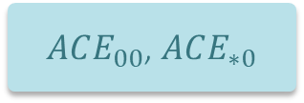

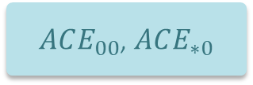
Simulation
Scenarios
Methods
ACE
ACE Evaluation
RESULTS
Outline
Simulation setup
Bias
Coverage Prob
Power
Type I Error
Summary
S1 (low trt effect, high IE rate)
Bayesian
$ACE_{00}$, $ACE_{∗0}$
Bias
S2 (low trt effect, low IE rate)
S3 (mod trt effect, high IE rate)
PS
$ACE_{00}$, $ACE_{∗0}$
Coverage Probability
S4 (mod trt effect, low IE rate)
PS (Cov-Adj)
$ACE_{00}^{adj}$, $ACE_{∗0}^{adj}$
Power
S5 (high trt effect, high IE rate)
AdACE
$ACE_{00}$, $ACE_{∗0}$
Type 1 Error
S6 (high trt effect, low IE rate)
S7 (zero trt effect, high IE rate)
S8 (zero trt effect, low IE rate)

Slide 3
Simulation (CITIES)
RESULTS
Outline
Simulation setup
Bias
Coverage Prob
Power
Type I Error
Summary
 | Scenario 1 [s1] | Scenario 2 [s2] | Scenario 3 [s3] | Scenario 4 [s4] | Scenario 5 [s5] | Scenario 6 [s6]
Trt eff | low 0.4 | low 0.4 | modest 0.8 | modest 0.8 | high 1.2 | high 1.2
P_loe_max | 0.5 | 0.3 | 0.5 | 0.3 | 0.5 | 0.3
P_ae_0 P_ae_1 | 0.2 0.2 | 0.08 0.08 | 0.2 0.2 | 0.08 0.08 | 0.2 0.2 | 0.08 0.08
Rate_dc_ae_0 Rate_dc_ae_1 | 0.2 0.2 | 0.08 0.08 | 0.2 0.2 | 0.08 0.08 | 0.2 0.2 | 0.08 0.08
Z_l_loe Z_u_loe P_ee_max Z_l_ee Z_u_ee | -7 -2.5 0 0 0 | -7 -2.5 0 0 0 | -7 -2.5 0 0 0 | -7 -2.5 0 0 0 | -7 -2.5 0 0 0 | -7 -2.5 0 0 0

Slide 4
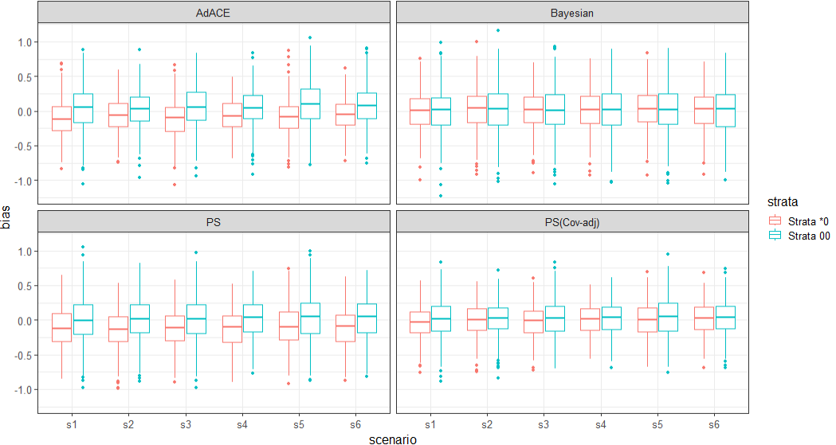

Bias
RESULTS
Outline
Simulation setup
Bias
Coverage Prob
Power
Type I Error
Summary
In Bayesian: E(bias) $≈0$ in both strata
In other methods: E(bias) $<0$ in S*0 → underestimate ACE
In all methods all scenarios: bias has wider CI in S00 .

Slide 5
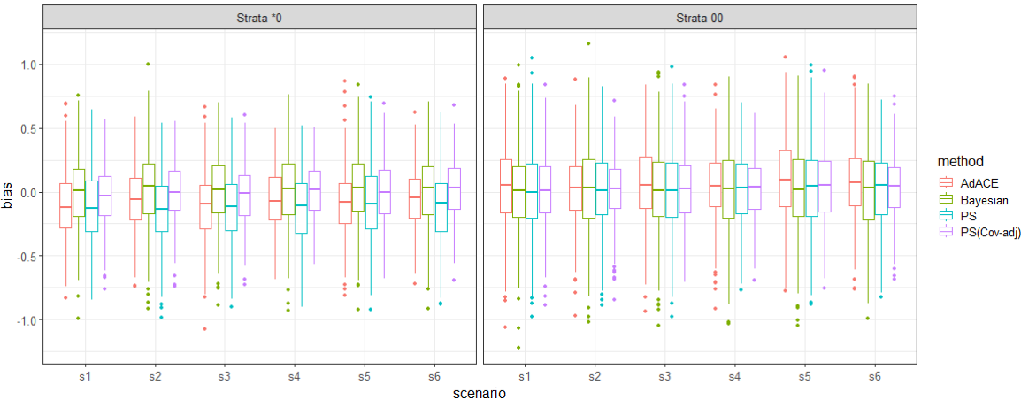
Bias
RESULTS
In S*0: AdACE, PS tend to underestimate ACE
Simulation
Outline
Simulation setup
Bias
Coverage Prob
Power
Type I Error
Summary
Results
PS(Cov-adj) has the narrowest CI in all scenarios and strata.

Slide 6
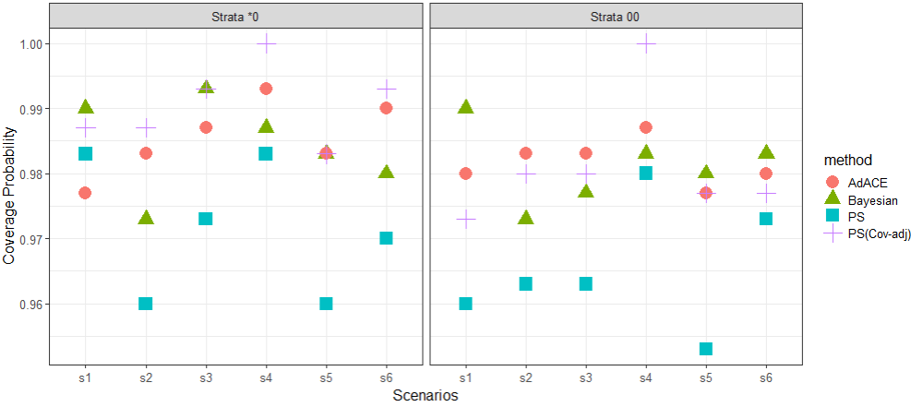
Coverage Probability across method
S00 : AdACE has the highest P.cover in most scenarios, PS has the lowest in all scenarios
RESULTS
Simulation
Outline
Simulation setup
Bias
Coverage Prob
Power
Type I Error
Summary
Results
PS performs poorest in most scenarios.
S*0 strata: PS(cov-adj) performs the best in most scenarios

Slide 7
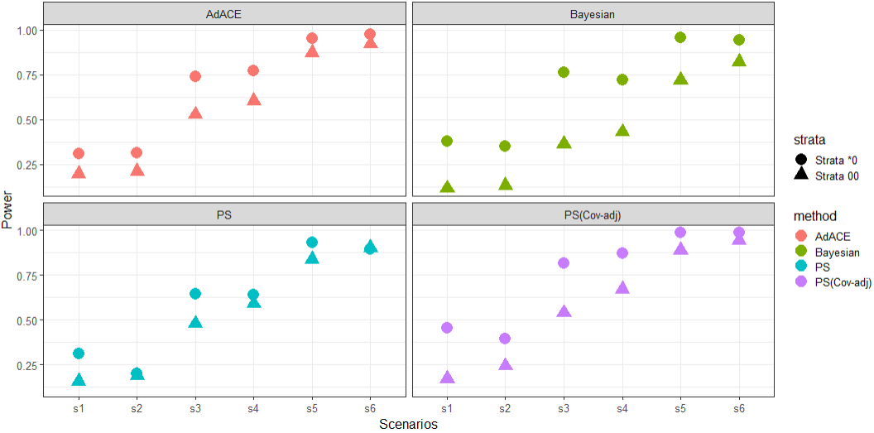
Power
S*0 always has higher power than S00.
RESULTS
Simulation
Outline
Simulation setup
Bias
Coverage Prob
Power
Type I Error
Summary
Results

Slide 8
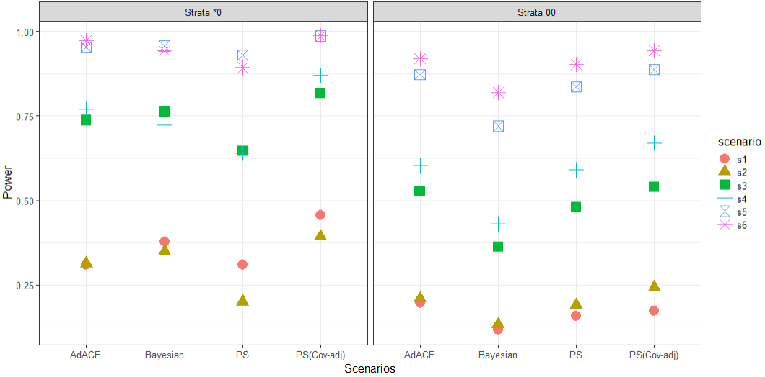
Power across scenario
(s1, s2) < (s3, s4) < (s5, s6), indicating larger treatment effect results in higher power.
RESULTS
Simulation
Outline
Simulation setup
Bias
Coverage Prob
Power
Type I Error
Summary
Results
s3<s4 , s5<s6 in S00, indicating higher IE rate results in lower power. No clear trend in other comparisons.

Slide 9
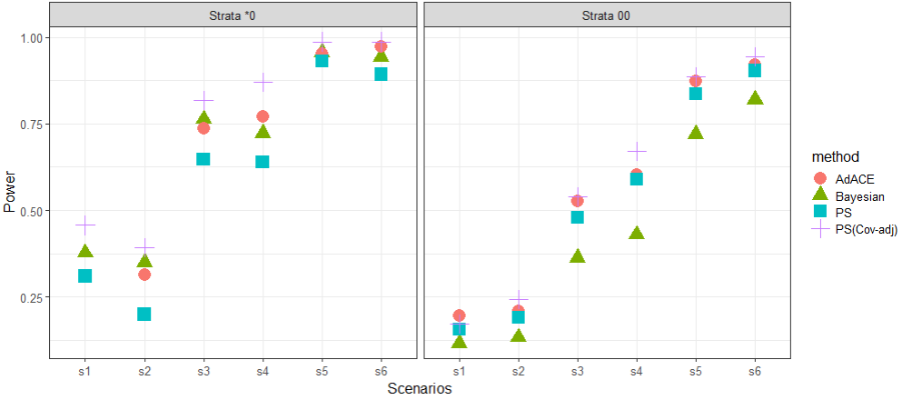
Power across methods
RESULTS
Simulation
Outline
Simulation setup
Bias
Coverage Prob
Power
Type I Error
Summary
Results
In S*0, PS(Cov-adj) has highest power, PS without cov-adj has the lowest
In S00, PS(Cov-adj) and AdACE outperform others in all scenarios, Bayesian has the lowest power in all scenarios.

Slide 10
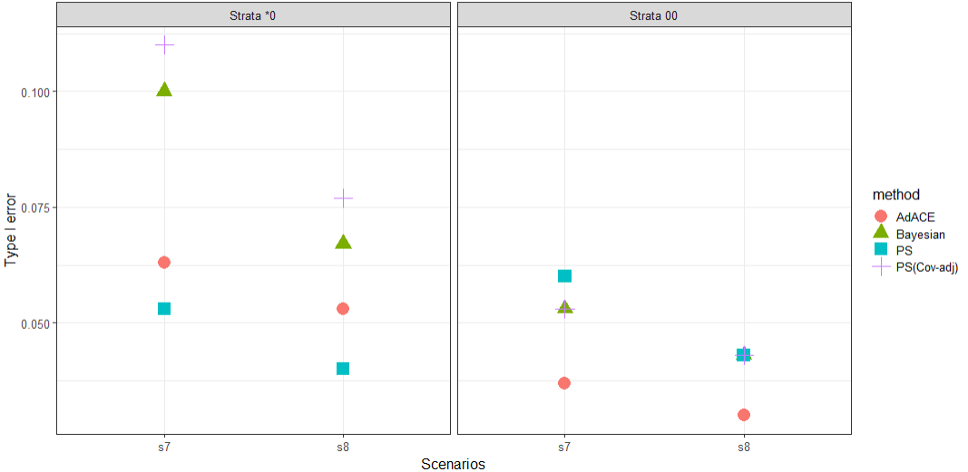
Type I error
S7 has higher Type I error than S8 for all methods and strata, indicating high IE rate results in higher type 1 error.
RESULTS
Simulation
Outline
Simulation setup
Bias
Coverage Prob
Power
Type I Error
Summary
Results
In S*0: Type I error tends to be large, most above 0.05. PS > AdACE >Bayesian > PS(cov-adj) In S00: AdACE has the lowest type I error below 0.03, others around 0.05

Slide 11
METHOD COMPARISON
Bayesian | Bias | more accurate ACE for all scenarios (E(bias) approx. 0), more stable across scenarios (other methods increase with trmt effect)
 | Coverage P | no obvious advantage/disadvantage
 | Power | lowest in S00 in all scenarios.
 | Type I error | not well performed in any scenario/strata
AdACE | Bias | tends to underestimate ACE in S*0, no obvious advantage
 | Coverage P | performs the best (highest) in S00.
 | Power | performs well in most scenarios and strata
 | Type I error | performs best in S00; performs average in S*0.
PS(Cov-adj) | Bias | has narrower bias CI in both strata for all scenarios
 | Coverage P | performs the best (highest) in S*0.
 | Power | performs well in most scenarios and strata
 | Type I error | not well performed in any scenario/strata
PS | Bias | tends to underestimate ACE in S*0, no obvious advantage
 | Coverage P | lowest in both strata in most scenarios.
 | Power | lowest in S*0 in all scenarios .
 | Type I error | performs best in S*0, not good in S00.
RESULTS
Simulation
Outline
Simulation setup
Bias
Coverage Prob
Power
Type I Error
Summary
Results

Slide 12
METHOD COMPARISON
Bayesian | Bias | more accurate ACE for all scenarios (E(bias) approx. 0), more stable across scenarios (other methods increase with trmt effect)
 | Coverage P | no obvious advantage/disadvantage
 | Power | lowest in S00 in all scenarios.
 | Type I error | not well performed in any scenario/strata
AdACE | Bias | tends to underestimate ACE in S*0, no obvious advantage
 | Coverage P | performs the best (highest) in S00.
 | Power | performs well in most scenarios and strata
 | Type I error | performs best in S00; performs average in S*0.
PS(Cov-adj) | Bias | has narrower bias CI in both strata for all scenarios
 | Coverage P | performs the best (highest) in S*0.
 | Power | performs well in most scenarios and strata
 | Type I error | not well performed in any scenario/strata
PS | Bias | tends to underestimate ACE in S*0, no obvious advantage
 | Coverage P | lowest in both strata in most scenarios.
 | Power | lowest in S*0 in all scenarios .
 | Type I error | performs best in S*0, not good in S00.
RESULTS
Simulation
Outline
Simulation setup
Bias
Coverage Prob
Power
Type I Error
Summary
Results

Slide 13
METHOD COMPARISON
Bayesian | Bias | more accurate ACE for all scenarios (E(bias) approx. 0), more stable across scenarios (other methods increase with trmt effect)
 | Coverage P | no obvious advantage/disadvantage
 | Power | lowest in S00 in all scenarios.
 | Type I error | not well performed in any scenario/strata
AdACE | Bias | tends to underestimate ACE in S*0, no obvious advantage
 | Coverage P | performs the best (highest) in S00.
 | Power | performs well in most scenarios and strata
 | Type I error | performs best in S00; performs average in S*0.
PS(Cov-adj) | Bias | has narrower bias CI in both strata for all scenarios
 | Coverage P | performs the best (highest) in S*0.
 | Power | performs well in most scenarios and strata
 | Type I error | not well performed in any scenario/strata
PS | Bias | tends to underestimate ACE in S*0, no obvious advantage
 | Coverage P | lowest in both strata in most scenarios.
 | Power | lowest in S*0 in all scenarios .
 | Type I error | performs best in S*0, not good in S00.
RESULTS
Simulation
Outline
Simulation setup
Bias
Coverage Prob
Power
Type I Error
Summary
Results

Slide 14
METHOD COMPARISON
Bayesian | Bias | more accurate ACE for all scenarios (E(bias) approx. 0), more stable across scenarios (other methods increase with trmt effect)
 | Coverage P | no obvious advantage/disadvantage
 | Power | lowest in S00 in all scenarios.
 | Type I error | not well performed in any scenario/strata
AdACE | Bias | tends to underestimate ACE in S*0, no obvious advantage
 | Coverage P | performs the best (highest) in S00.
 | Power | performs well in most scenarios and strata
 | Type I error | performs best in S00; performs average in S*0.
PS(Cov-adj) | Bias | has narrower CI in both strata for all scenarios
 | Coverage P | performs the best (highest) in S*0.
 | Power | performs well in most scenarios and strata
 | Type I error | not well performed in any scenario/strata
PS | Bias | tends to underestimate ACE in S*0, no obvious advantage
 | Coverage P | lowest in both strata in most scenarios.
 | Power | lowest in S*0 in all scenarios .
 | Type I error | performs best in S*0, not good in S00.
RESULTS
Simulation
Outline
Simulation setup
Bias
Coverage Prob
Power
Type I Error
Summary
Results

Slide 15
METHOD COMPARISON
Bayesian | Bias | more accurate ACE for all scenarios (E(bias) approx. 0), more stable across scenarios (other methods increase with trmt effect)
 | Coverage P | no obvious advantage/disadvantage
 | Power | lowest in S00 in all scenarios.
 | Type I error | not well performed in any scenario/strata
AdACE | Bias | tends to underestimate ACE in S*0, no obvious advantage
 | Coverage P | performs the best (highest) in S00.
 | Power | performs well in most scenarios and strata
 | Type I error | performs best in S00; performs average in S*0.
PS(Cov-adj) | Bias | has narrower CI in both strata for all scenarios
 | Coverage P | performs the best (highest) in S*0.
 | Power | performs well in most scenarios and strata
 | Type I error | not well performed in any scenario/strata
PS | Bias | tends to underestimate ACE in S*0, no obvious advantage
 | Coverage P | lowest in both strata in most scenarios.
 | Power | lowest in S*0 in all scenarios .
 | Type I error | performs best in S*0, not good in S00.
RESULTS
Simulation
Outline
Simulation setup
Bias
Coverage Prob
Power
Type I Error
Summary
Results

Slide 16
RESULTS
Simulation
Outline
Simulation setup
Bias
Coverage Prob
Power
Type I Error
Summary
GENERAL FINDINGS
1. Bias (or ACE) has wider CI in S00 than in S*0.
2. Power tends to increase with effect size and decrease with IE rate.
3. Type I error tends to increase with IE rates.
Results

